Slide 1

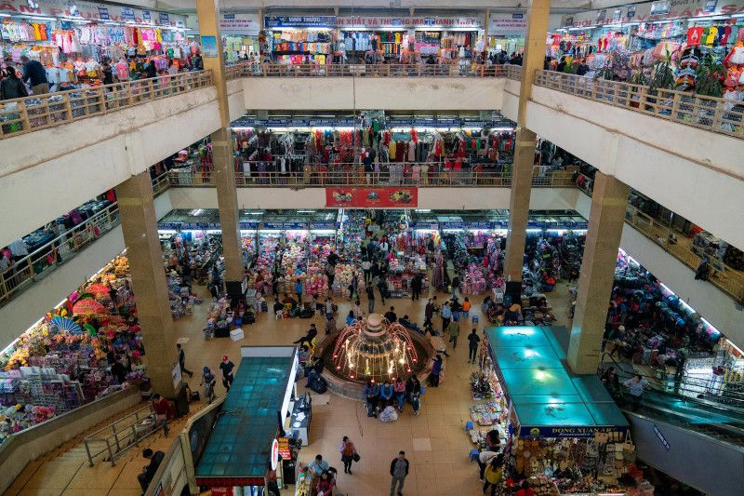
CUSTOMER ANALYSIS
IN A MALL
BY
KARTHY K

Slide 2
AGENDA
ABSTRACT
PROBLEM DEFINITION
DATA SET EXPLANATION
DATA ANALYSIS
DATA VISUALIZATION
K MEANS CLUSTERING
CONCLUSION

Slide 3

ABSTRACT:
The primary aim of the Customer analysis in a mall is Customer segmentation. Customer segmentation is a separation of a market into multiple distinct groups of consumers who share the similar characteristics. Segmentation of market is an effective way to define and meet customer needs.
The Customer segmentation data set has been taken from Kaggle, which contain 200records and 5 attributes. Correlation Test, Z-test, Poisson’s distribution and K-Means Clustering Algorithms are implemented to perform customer segmentation.
The results are analysed based on the annual income and spending score of the customers using the customer segmentation and they are visualized with the help of graph.

Slide 4

PROBLEM DEFINITION:
The aim is to understand the customers like who can be easily converge [Target Customers] so that the sense can be given to marketing team and plan the strategy accordingly
The dataset is extracted from Kaggle website.
For data analysis Descriptive statistics, correlation, Poisson distribution, graphical representation of data and K means clustering are performed.
The data analysis is also visualized graphically.

Slide 5


DATASET EXPLANATION:
The analysis is made with the help dataset extracted from Kaggle website.
The data contains details of customer in a mall in a single day. The dataset consists of 5 columns and 200 rows.
The columns has the following details:
    ID : contains the id of each customer.
    Gender :contains the gender of each customer (male/female).
    Age :contains the age of the customer.
    Annual Income :contains the annual income of customers in thousand dollars.
    Spending score :contains the customer’s spending ratio (based on customer behaviour and spending nature)

Slide 6

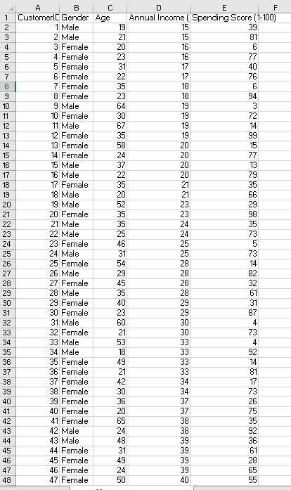
DATASET:

Slide 7

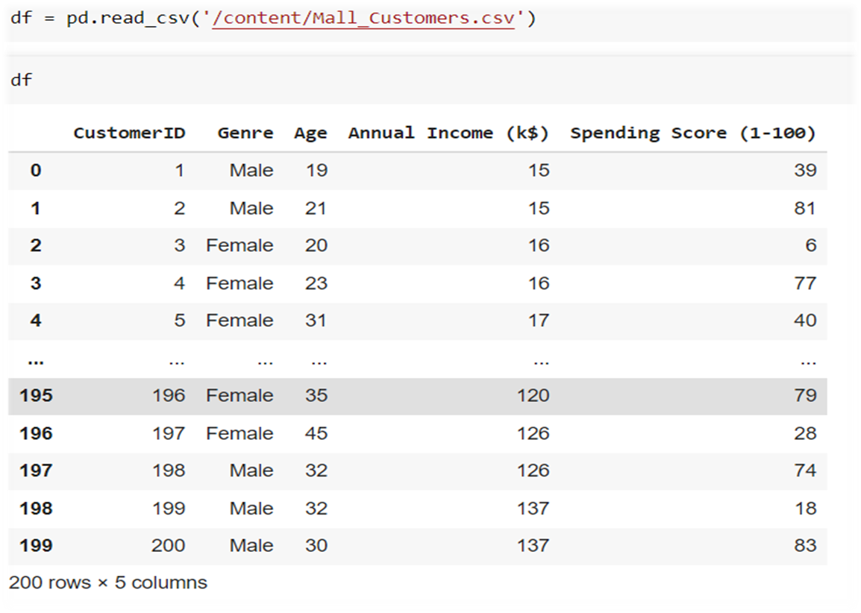
LOADING DATASET:

Slide 8

DESCRIPTIVE STATISTICS:
Descriptive statistics are brief descriptive coefficients that summarize a given data set, which can be either a representation of the entire population or a sample of a population.
Descriptive statistics consists of two basic categories of measures: measures of central tendency and measures of variability (or spread).
Measures of central tendency describe the center of a data set.
Measures of variability describe the dispersion of data including include standard deviation, variance, minimum and maximum variables, kurtosis, and skewness within the dataset.

Slide 9

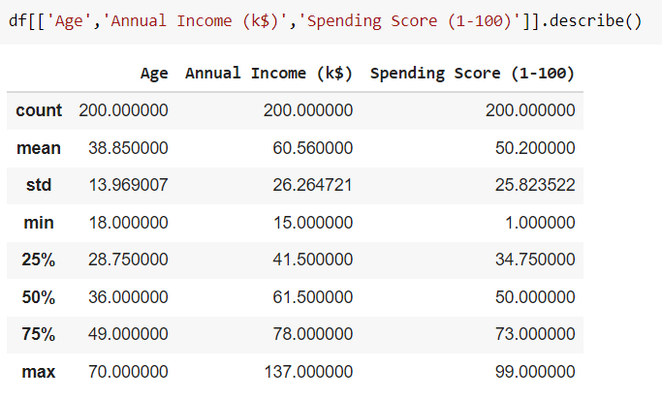
CODE WITH OUTPUT:

Slide 10

INFERENCE:
The count is 200 means that there have records of 200 customers .
The minimum age of customer in the dataset is 18 yrs and maximum age is 70.
The mean here is 38 and median is 36.Here Mean>Median means the data has high outliers ie more of youngsters prefer to go malls.
The minimum annual income of customer is 15k$ and maximum is 137k$.T
The mean and median here is 60k$ and 61k$ respectively.
Spending Score is something that is assigned to the customer based on the defined parameters like customer behavior and purchasing data.Here the minimum spending score assigned is 1 and maximum ranges till 99.Both mean and median is 50.

Slide 11

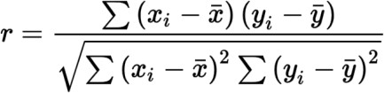
CORRELATION:
Correlation is the study of relationship between two or more variables . For example : there are two continuous variables X and Y and if the change in X affects Y, the variables are said to be correlated. In other words, the systematic relationship between the variables is termed as correlation. Therefore, correlation is a statistic that measures the degree to which two variables move in relation to each other.
Positive correlation : When the variables move in the same direction, these variables are said to be positively correlated.
Negative correlation : If the variables move in the opposite direction they are said to be negatively correlated.
Pearson’s correlation coefficient (formula) :

Slide 12


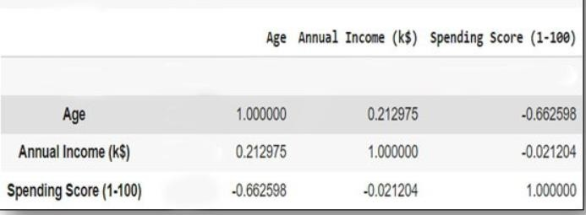
CODE WITH OUTPUT:
The correlation of the age, annual income and spending score is calculated.
Age and spending score have negative correlation whereas annual income and age have positive correlation.

Slide 13


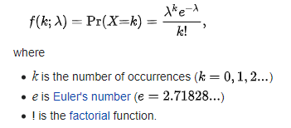
POISSON DISTRIBUTION:
Poisson distribution is a probability distribution that can be used to show how many times an event is likely to occur within a specified period of time.
poisson.rvs() method which takes μ as a shape parameter and is nothing but the λ in the equation. To shift distribution use the loc parameter. size decides the number of random variates in the distribution

Slide 14

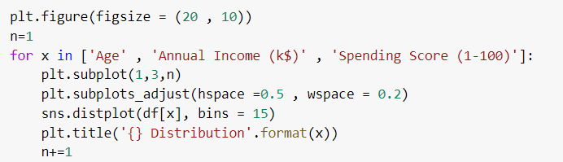
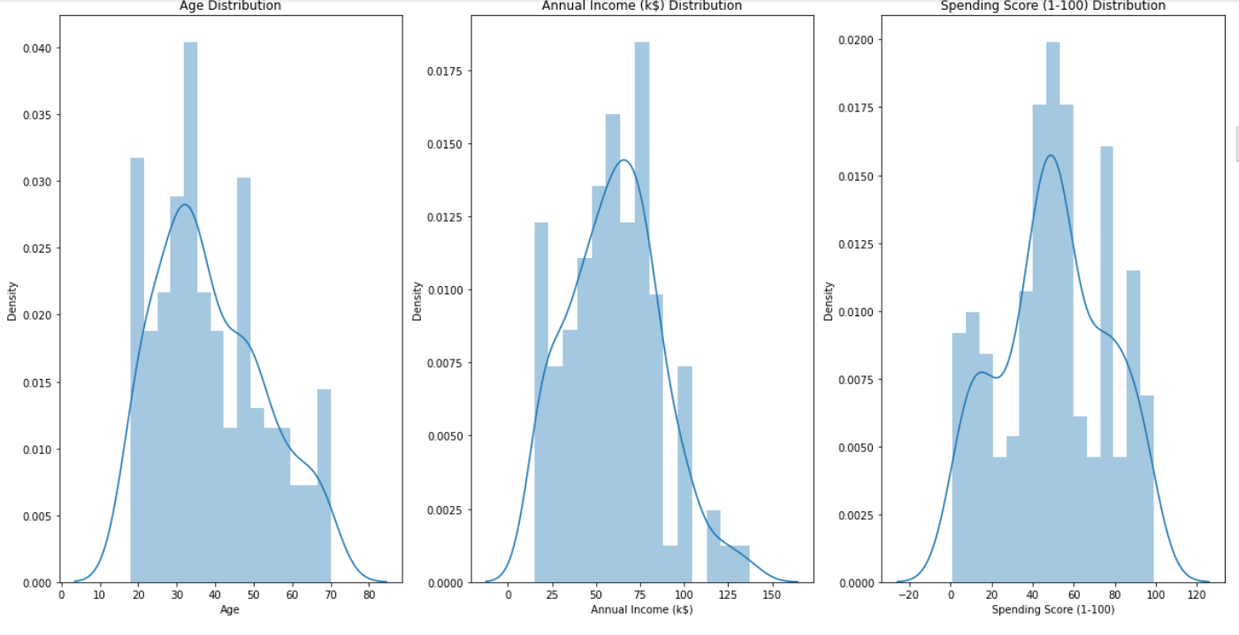
CODE WITH OUTPUT:

Slide 15

INFERENCE:
The chart on the left reveals that there are customers of a wide variety of ages. The most customers are from the age group of 30-40
From the middle chart it is clear that most of the annual income of the customers visiting malls falls between 50K to 85K in dollars.
The chart on the right shows that maximum spending score of customers is in the range of 40 to 60.

Slide 16

DATA VISUALIZATION:
Data visualization is the practice of translating information into a visual context, such as a map or graph, to make data easier for the human brain to understand and pull insights from.
The main goal of data visualization is to make it easier to identify patterns, trends and outliers in large data sets

Slide 17

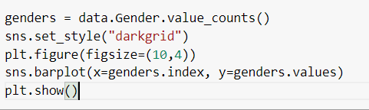
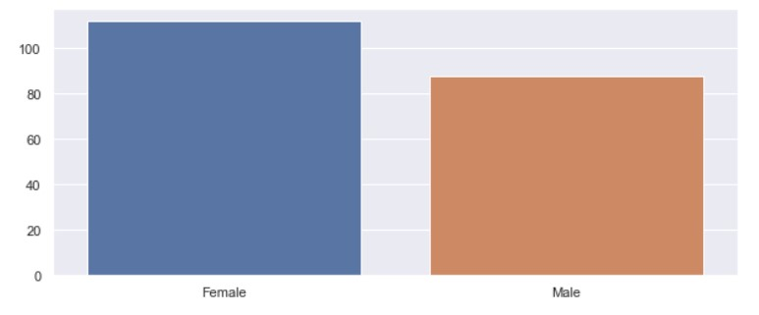
GENDER ANALYSIS:
From the above bar chart it is clear that the number of females is higher than the males.

Slide 18

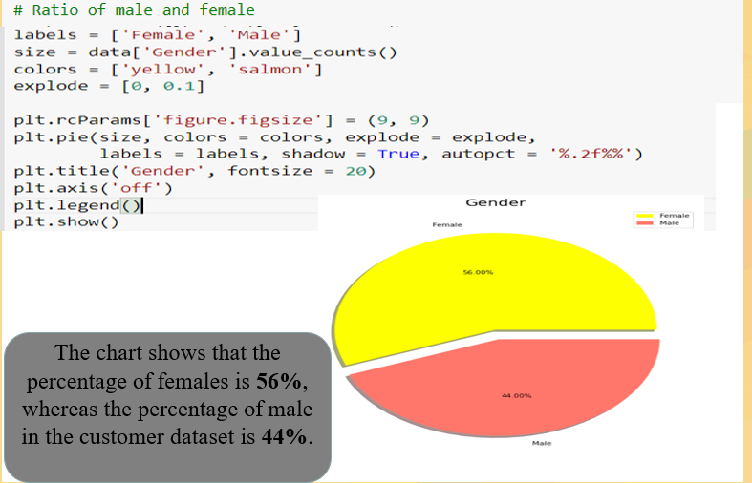
RATIO OF MALE AND FEMALE:

Slide 19

K MEANS CLUSTERING:
Method of K-means clustering :
Specify the number of clusters that is need to create.
The algorithm selects k objects at random from the dataset. This object is the initial cluster or mean.
The closest centroid obtains the assignment of a new observation. The base of this assignment is on the Euclidean Distance between object and the centroid.
k clusters in the data points update the centroid through calculation of the new mean values present in all the data points of the cluster. The kth cluster’s centroid has a length of p that contains means of all variables for observations in the k-th cluster. The number of variables is denoted with p.
Iterative minimization of the total within the sum of squares. Then through the iterative minimization of the total sum of the square, the assignment stops wavering when maximum iteration is achieved. The default value is 10 that the R software uses for the maximum iterations.

Slide 20
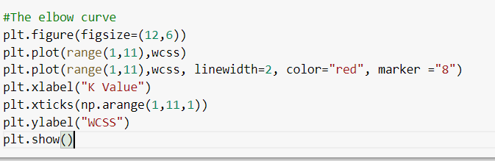
Elbow Method
The main goal behind cluster partitioning methods like k-means is to define the clusters such that the intra-cluster variation stays minimum.
minimize(sum W(Ck)), k=1…k
Where Ck represents the kth cluster and W(Ck) denotes the intra-cluster variation. With the measurement of the total intra-cluster variation, one can evaluate the compactness of the clustering boundary.

Slide 21

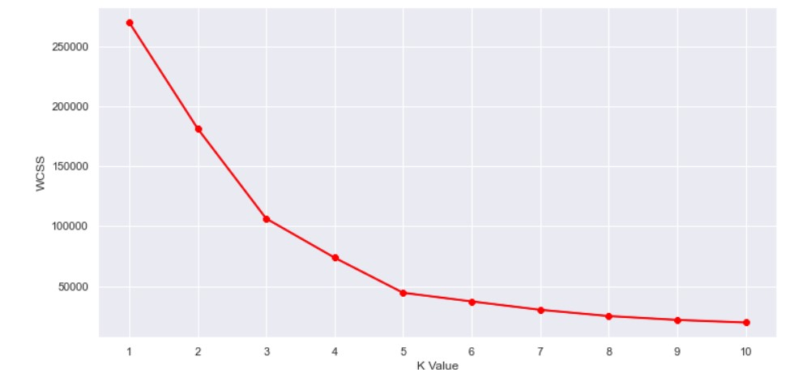
OUTPUT:
This is known as the elbow graph, the x-axis being the number of clusters, the number of clusters is taken at the elbow joint point. This point is the point where making clusters is most relevant as y-axis suddenly stops decreasing. Here in the graph, after 5 the drop is minimal, so we take 5 to be the number of clusters.

Slide 22

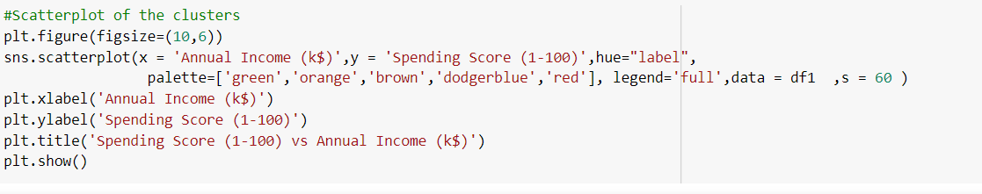
SCATTERPLOT OF THE CLUSTERS:
Here we have considered only two attributes of the dataset for clustering namely annual income and spending score

Slide 23

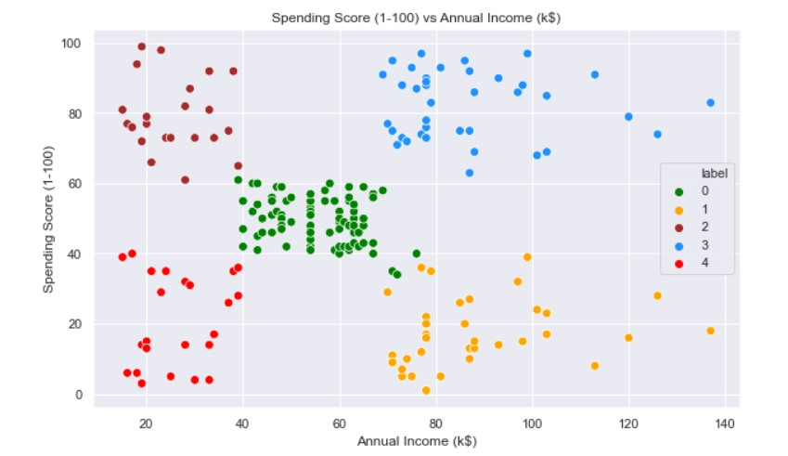
OUTPUT:
Here five different clusters have been formed from the data. The red cluster is the customers with the least income and least spending score, similarly, the blue cluster is the customers with the most income and most spending score

Slide 24

CONCLUSION:
This paper has brought out many segementation using K means clustering and visualizations about the customer visiting mall everyday.
K-Means clustering is a powerful technique for classifying data into different categories.
The customer segmentation allows to understand the behavior of different customers and accordingly helps to plan marketing strategy.
Clusters are been created and learned how to understand the profiles of the customers in different segments.

Slide 25

FUTURE SCOPE:
In future, we will try to improve the accuracy of the result by using more advanced techniques and will try to give out the bestest result.
Also, the current dataset contains only the age, spending score and annual income of the customer, in future customer category and spending time can be included that will help the owner to understand where they have concentrate more. This will help to improve the quality of the mall.

Slide 26

REFERENCES:
https://realpython.com/numpy-scipy- pandas-correlation-python/
https://pandas.pydata.org/pandas- docs/version/1.3/reference/api/pandas.DataFra me.groupby.html
https://towardsdatascience.com/mall- customers-segmentation-using-machine- learning-274ddf5575d5
https://www.kaggle.com/roshansharma/mal l-customers-clustering-analysis

Slide 27

THANK YOU!

